Slide 1

SESHADRI RAO GUDLAVALLERU ENGINEERING COLLEGE
Department of Computer Science and Engineering
MINI PROJECT
On
A Dashboard For Services Utilization At Airport Using IoT Analytics
By
19481A05M9 – S. B. Mukesh
19481A05O9 – V. Teja Sri
19481A05K1 – P. Praveen Kumar
Under the Guidance of
Mr. J. N. V. R. Swarup Kumar

Slide 2


PROBLEM STATEMENT
In the present growing world, there are abundant resources and services available to the people, but a question arises how far they have been utilized?
This question comes to mind. Investing money on the resources that are not utilized or have minimum utilization is a waste of expenditure.
This problem can be resolved with our project A Dashboard for Services Utilization at Airports using IoT Analytics.

Slide 3
ABSTRACT
It is difficult to analyze which resources are in high demand in public places. Barcode is a visual representation of information. By using barcodes present on the government authorized identities authorities can analyze which service has maximum demand can moderate the resources.

Slide 4
Proposed Method
The barcode scanner scan’s the Government authorized id cards in order to utilize a service.
And then it will be update in the database which service has been used by the customer.
By using the updated data in the database, we will be displaying the stats on the website with visual effects, which states, which airport has utilized all the services on a daily or Monthly or Yearly bases as per the selection.

Slide 5

EXISTING METHODOLOGIES
Currently there is no
Existing methodology
But if we take Installation
of a service into consideration then,
there will be a record of how many
number of products have been purchased
But there would be no tracking down of
how the utilization has been taking place now.

Slide 6
Architecture

Slide 7
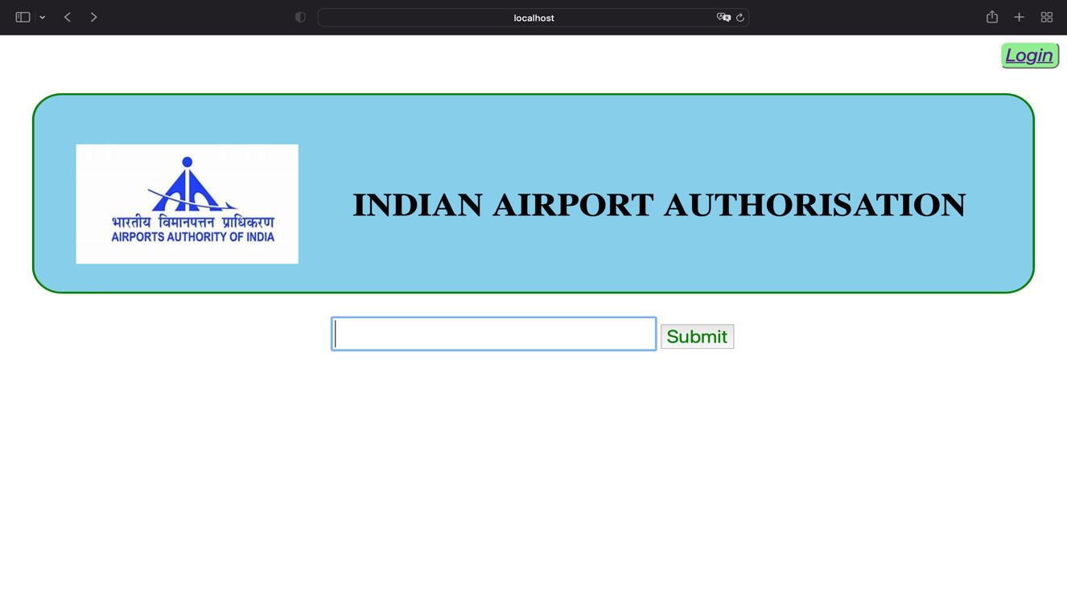
IMPLEMENTATION

Slide 8
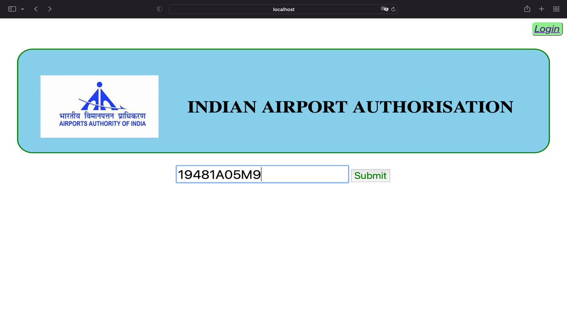

Slide 9
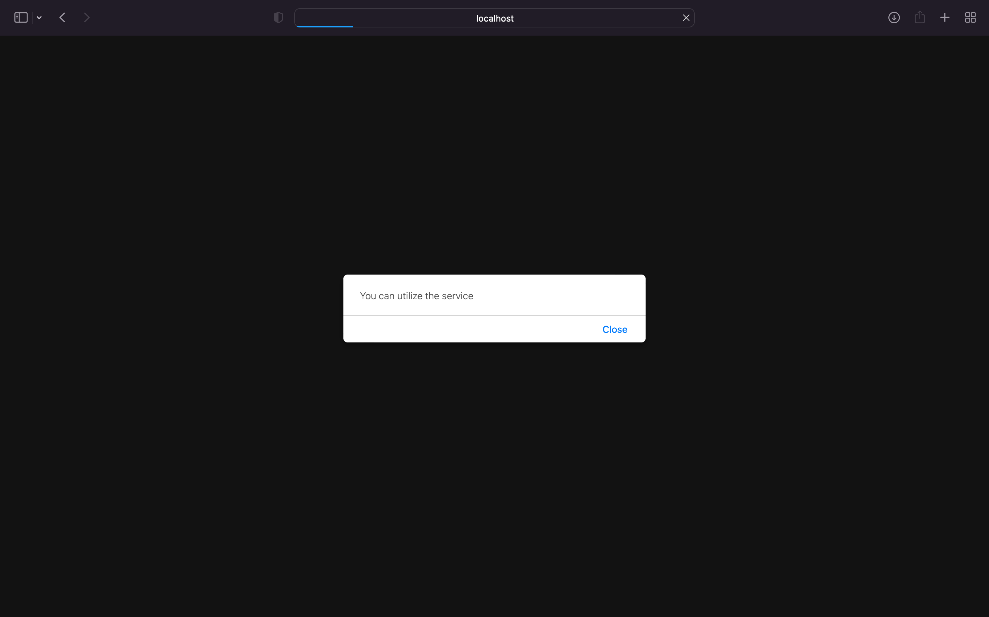

Slide 10
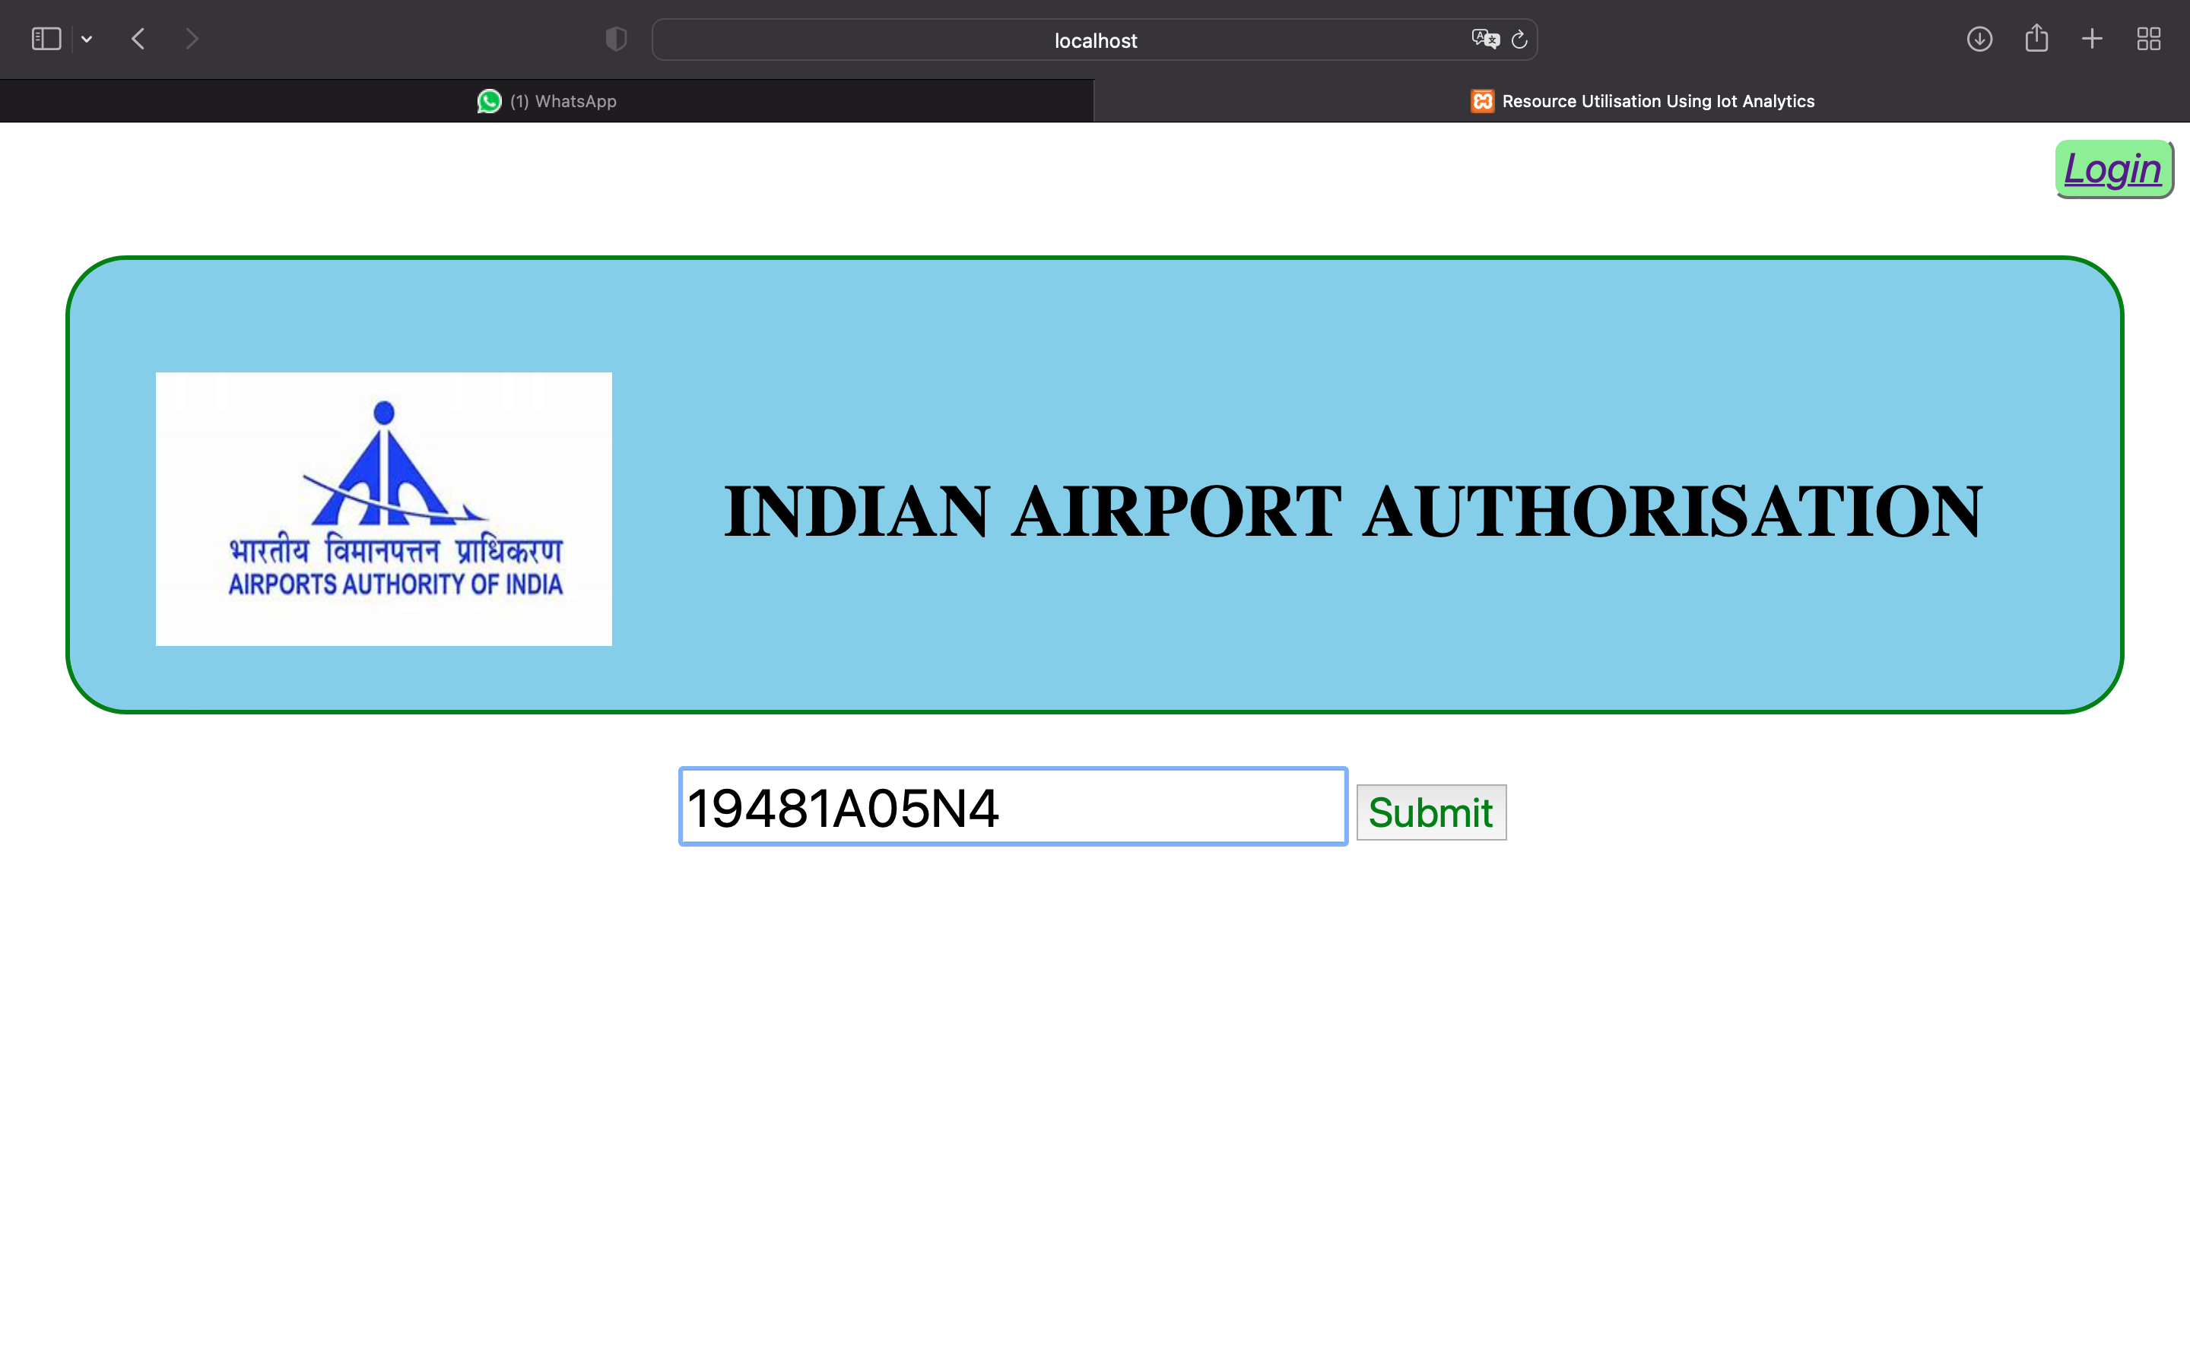

Slide 11
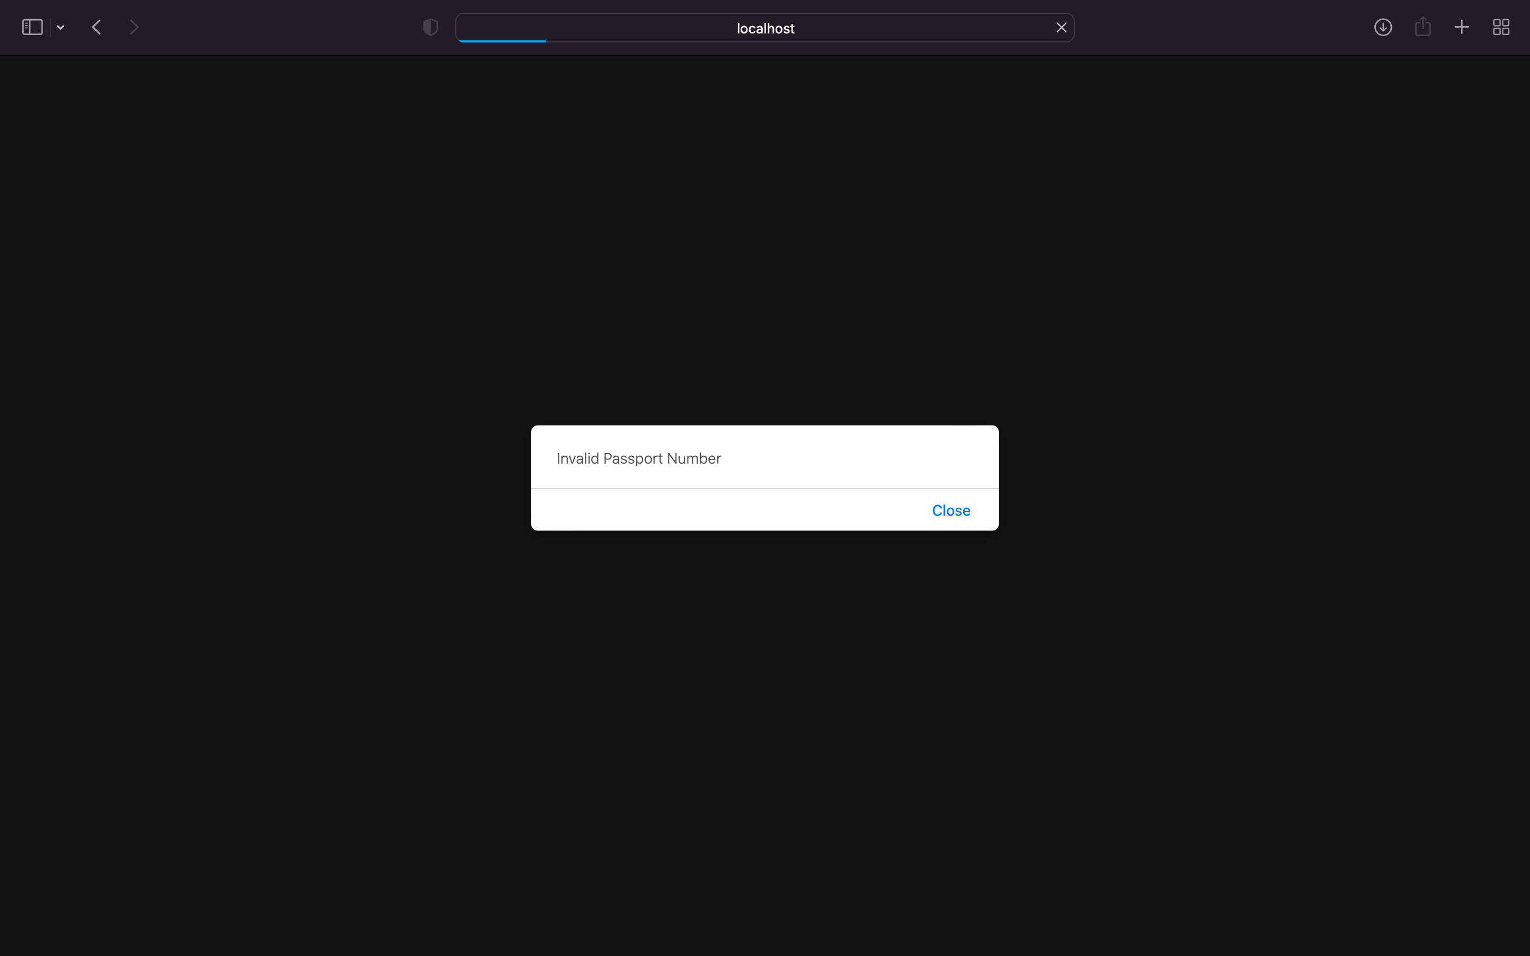

Slide 12
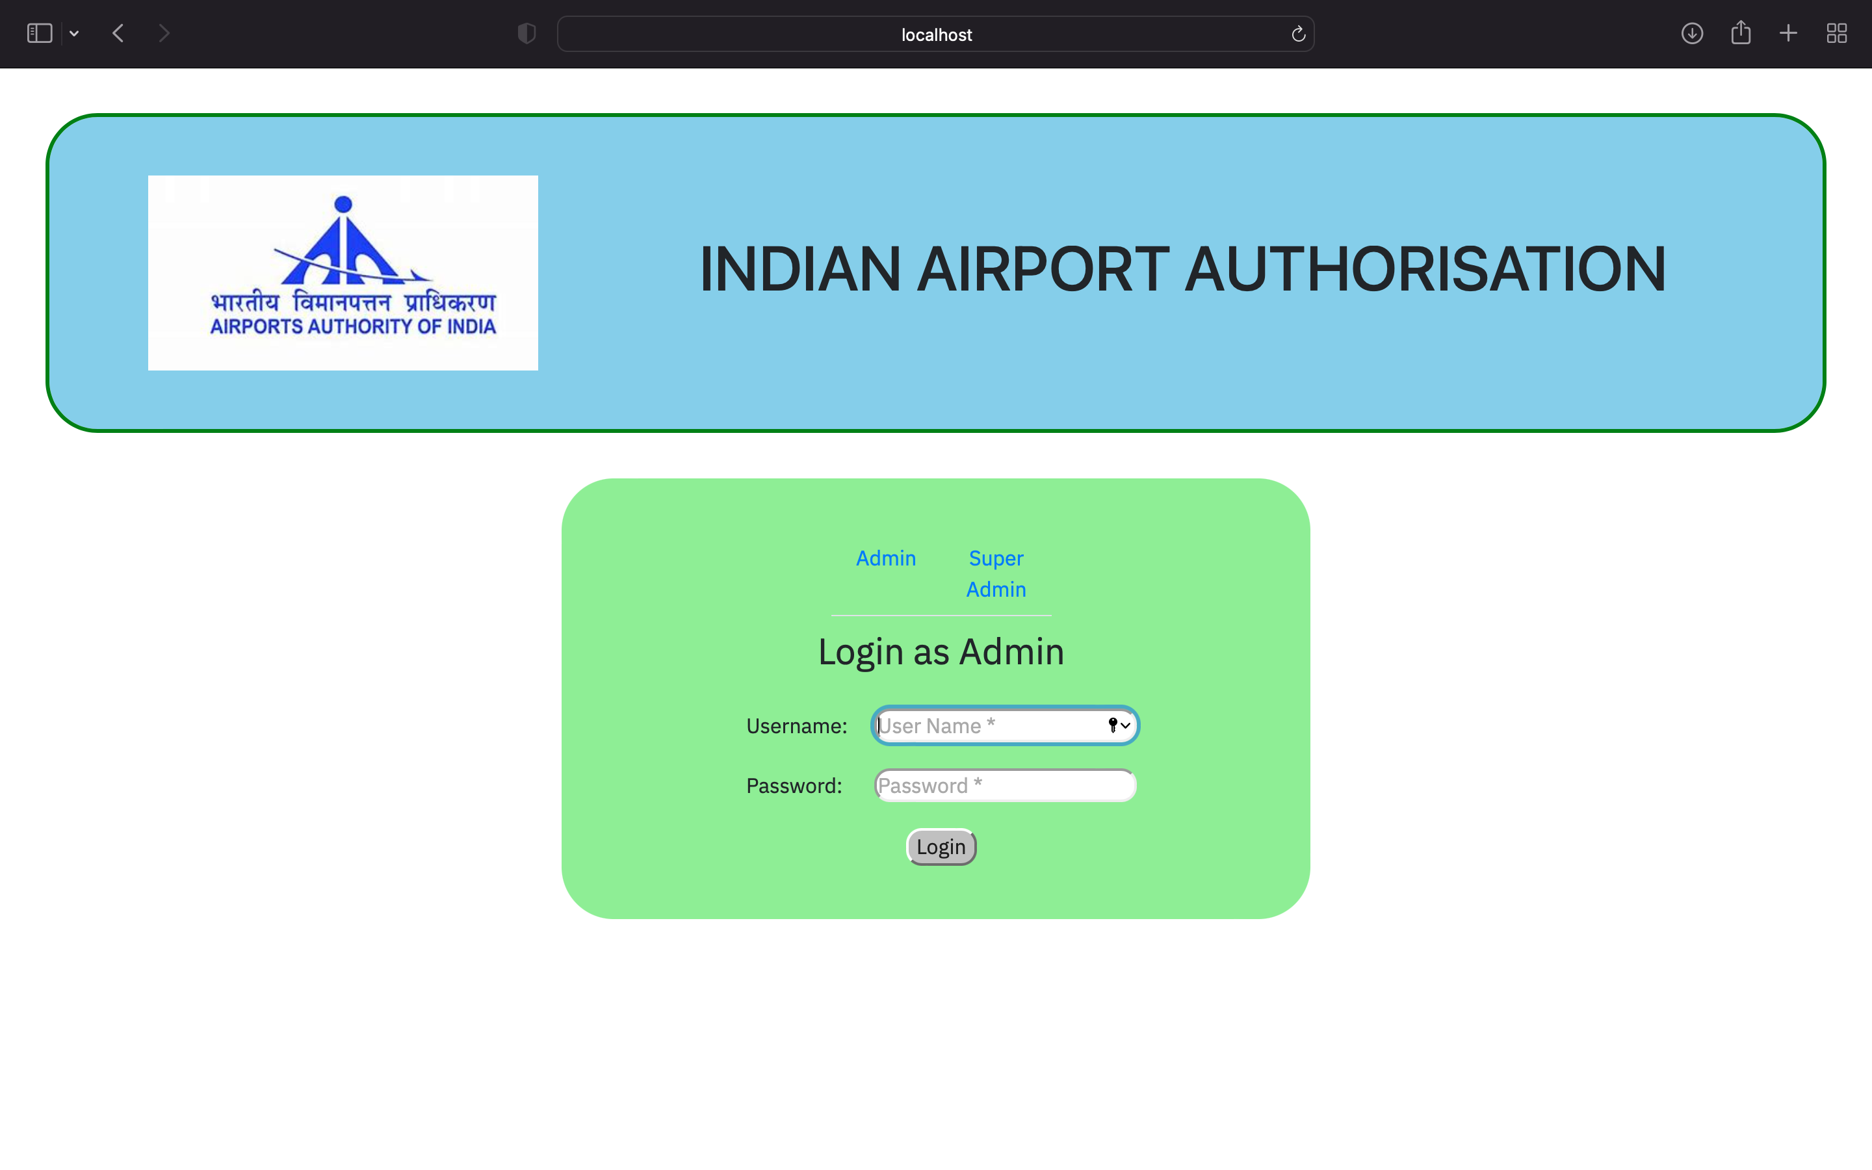

Slide 13
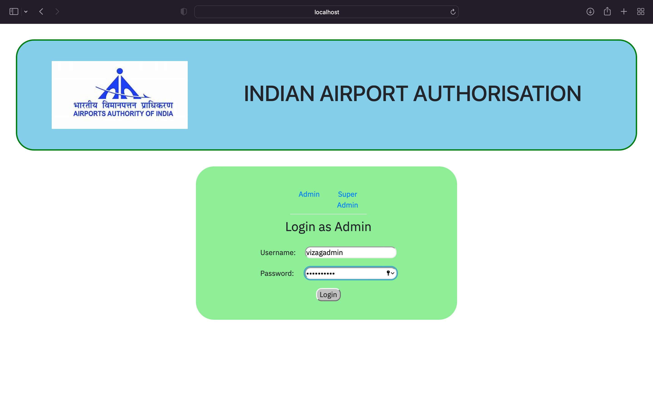

Slide 14
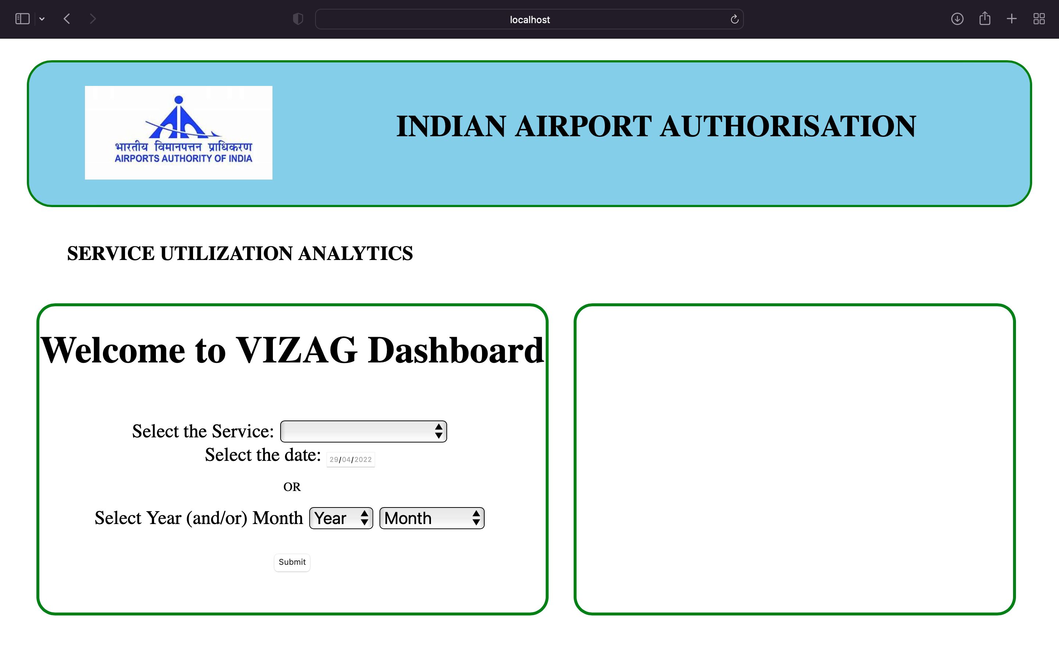

Slide 15
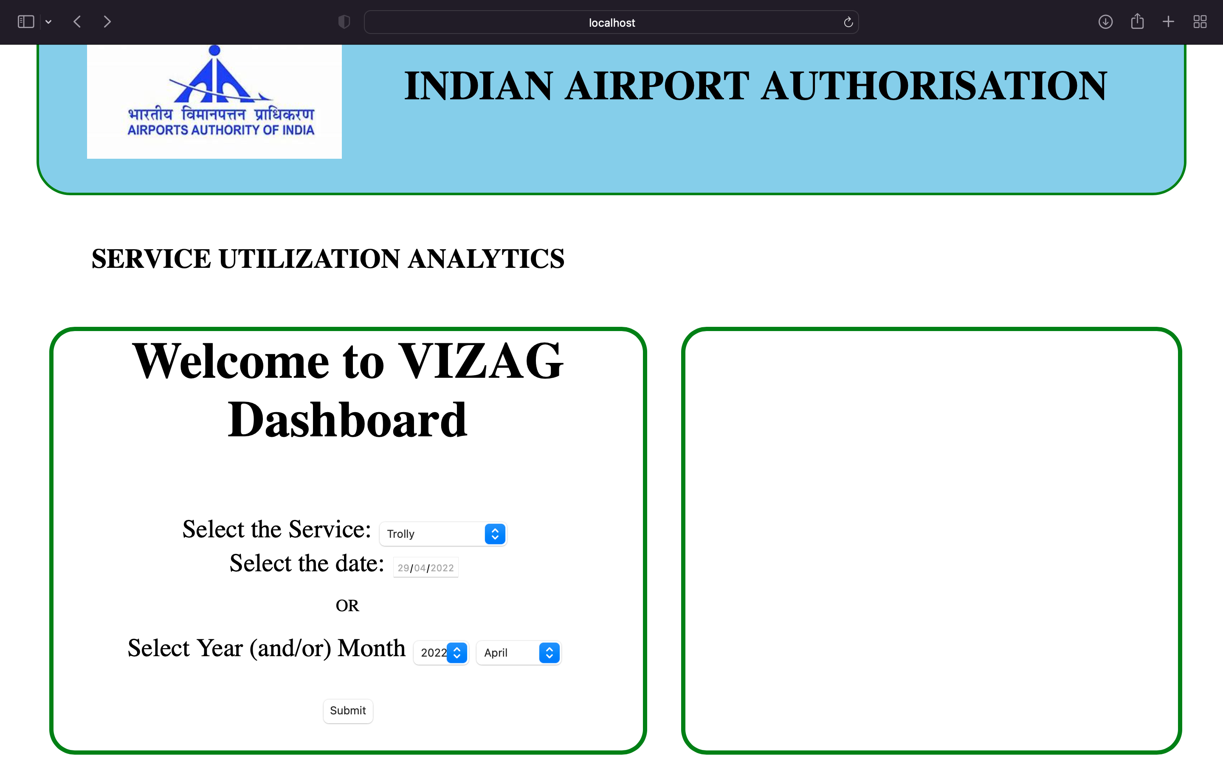

Slide 16
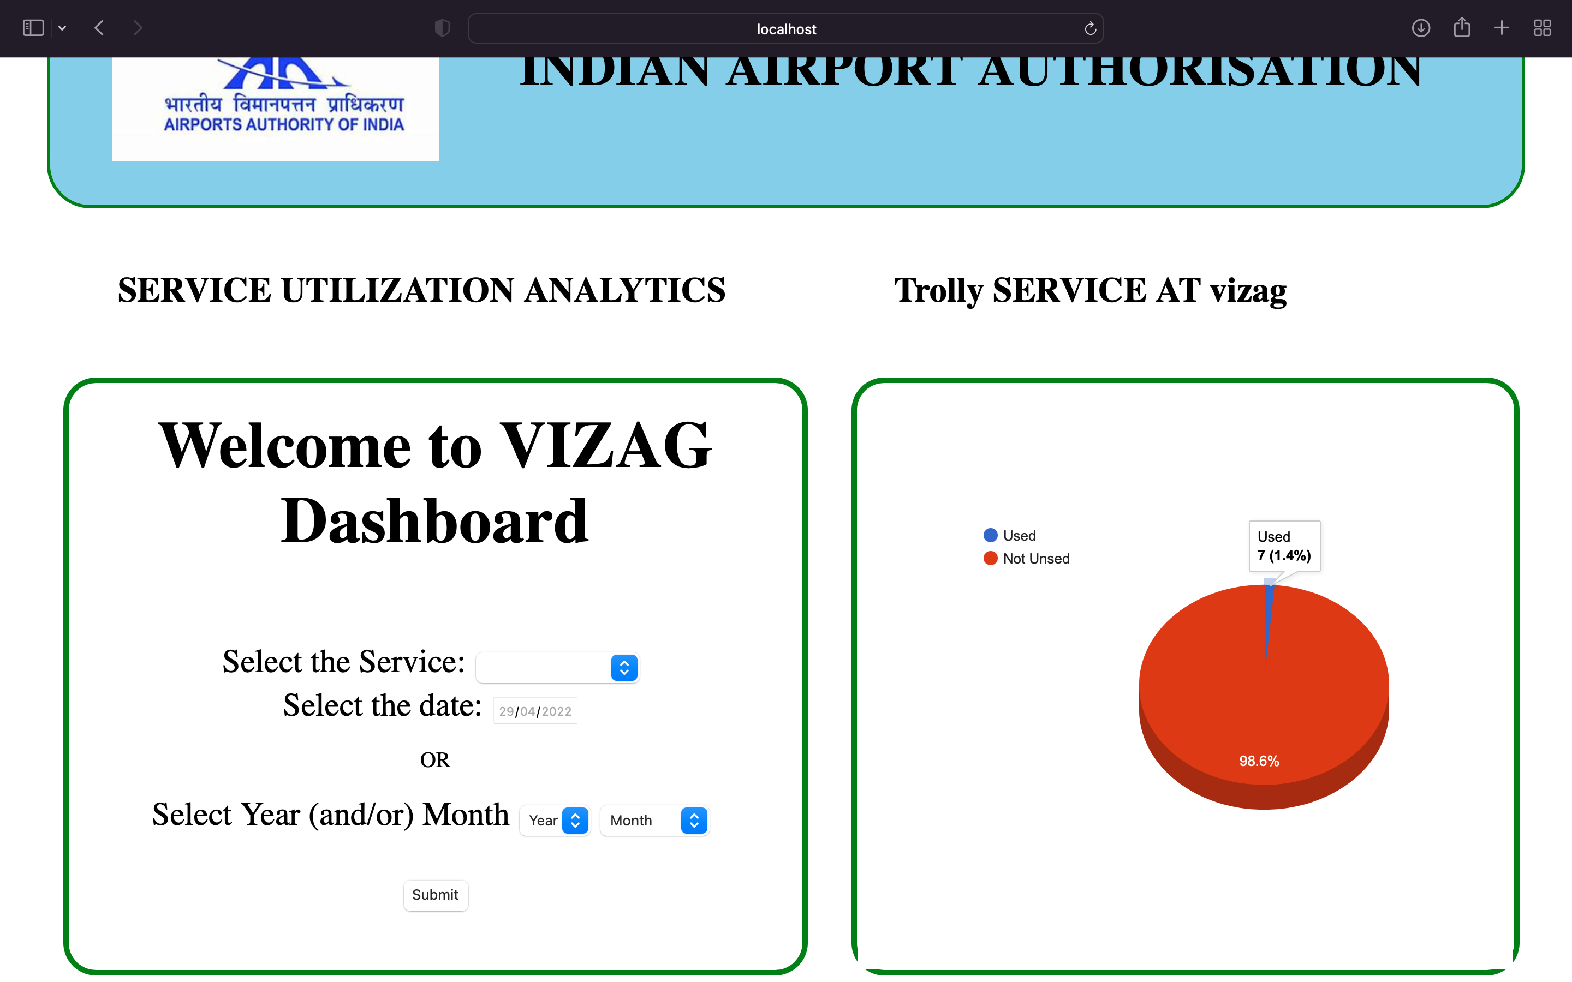

Slide 17
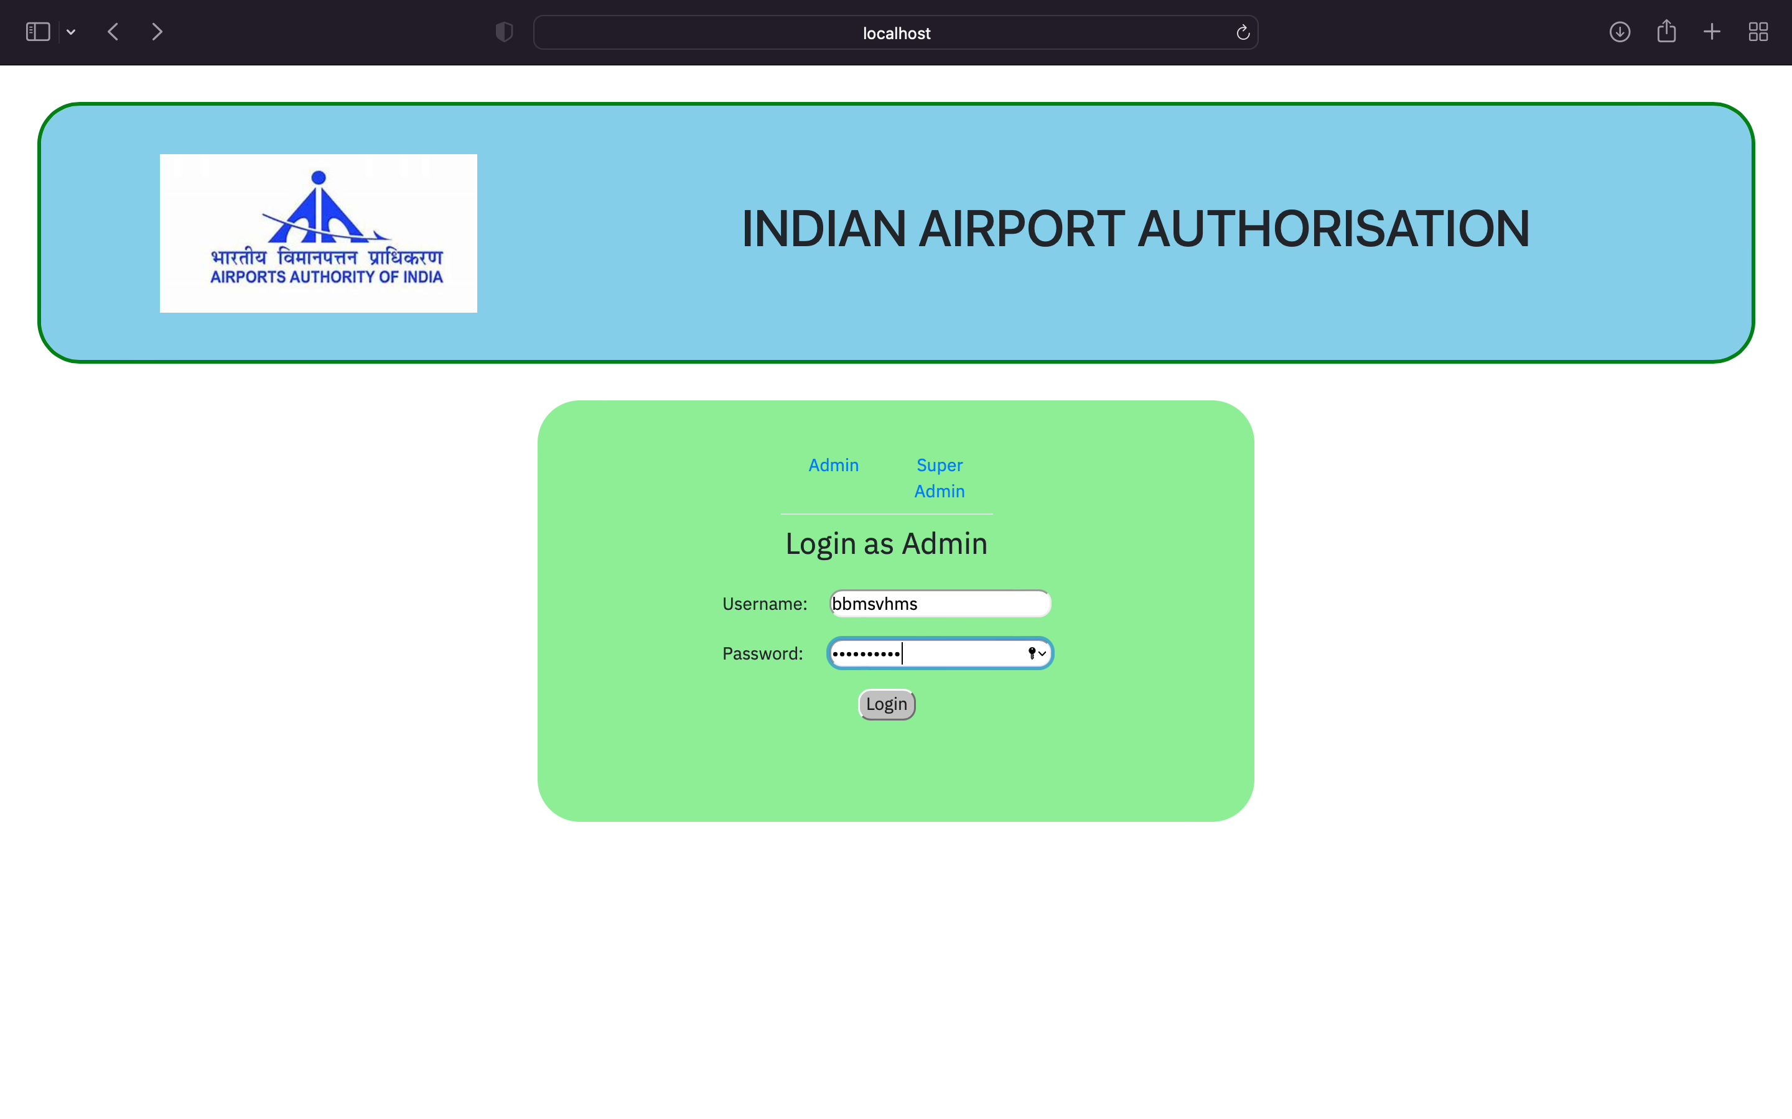

Slide 18
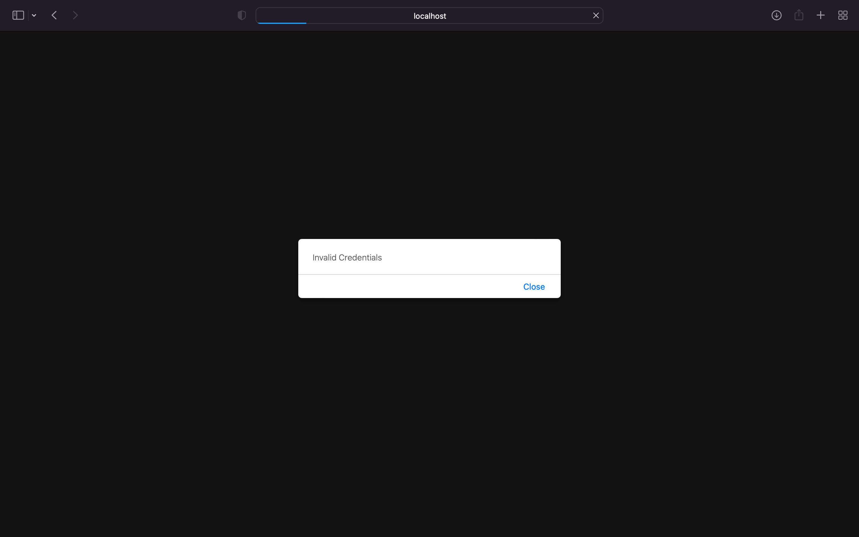

Slide 19


Slide 20
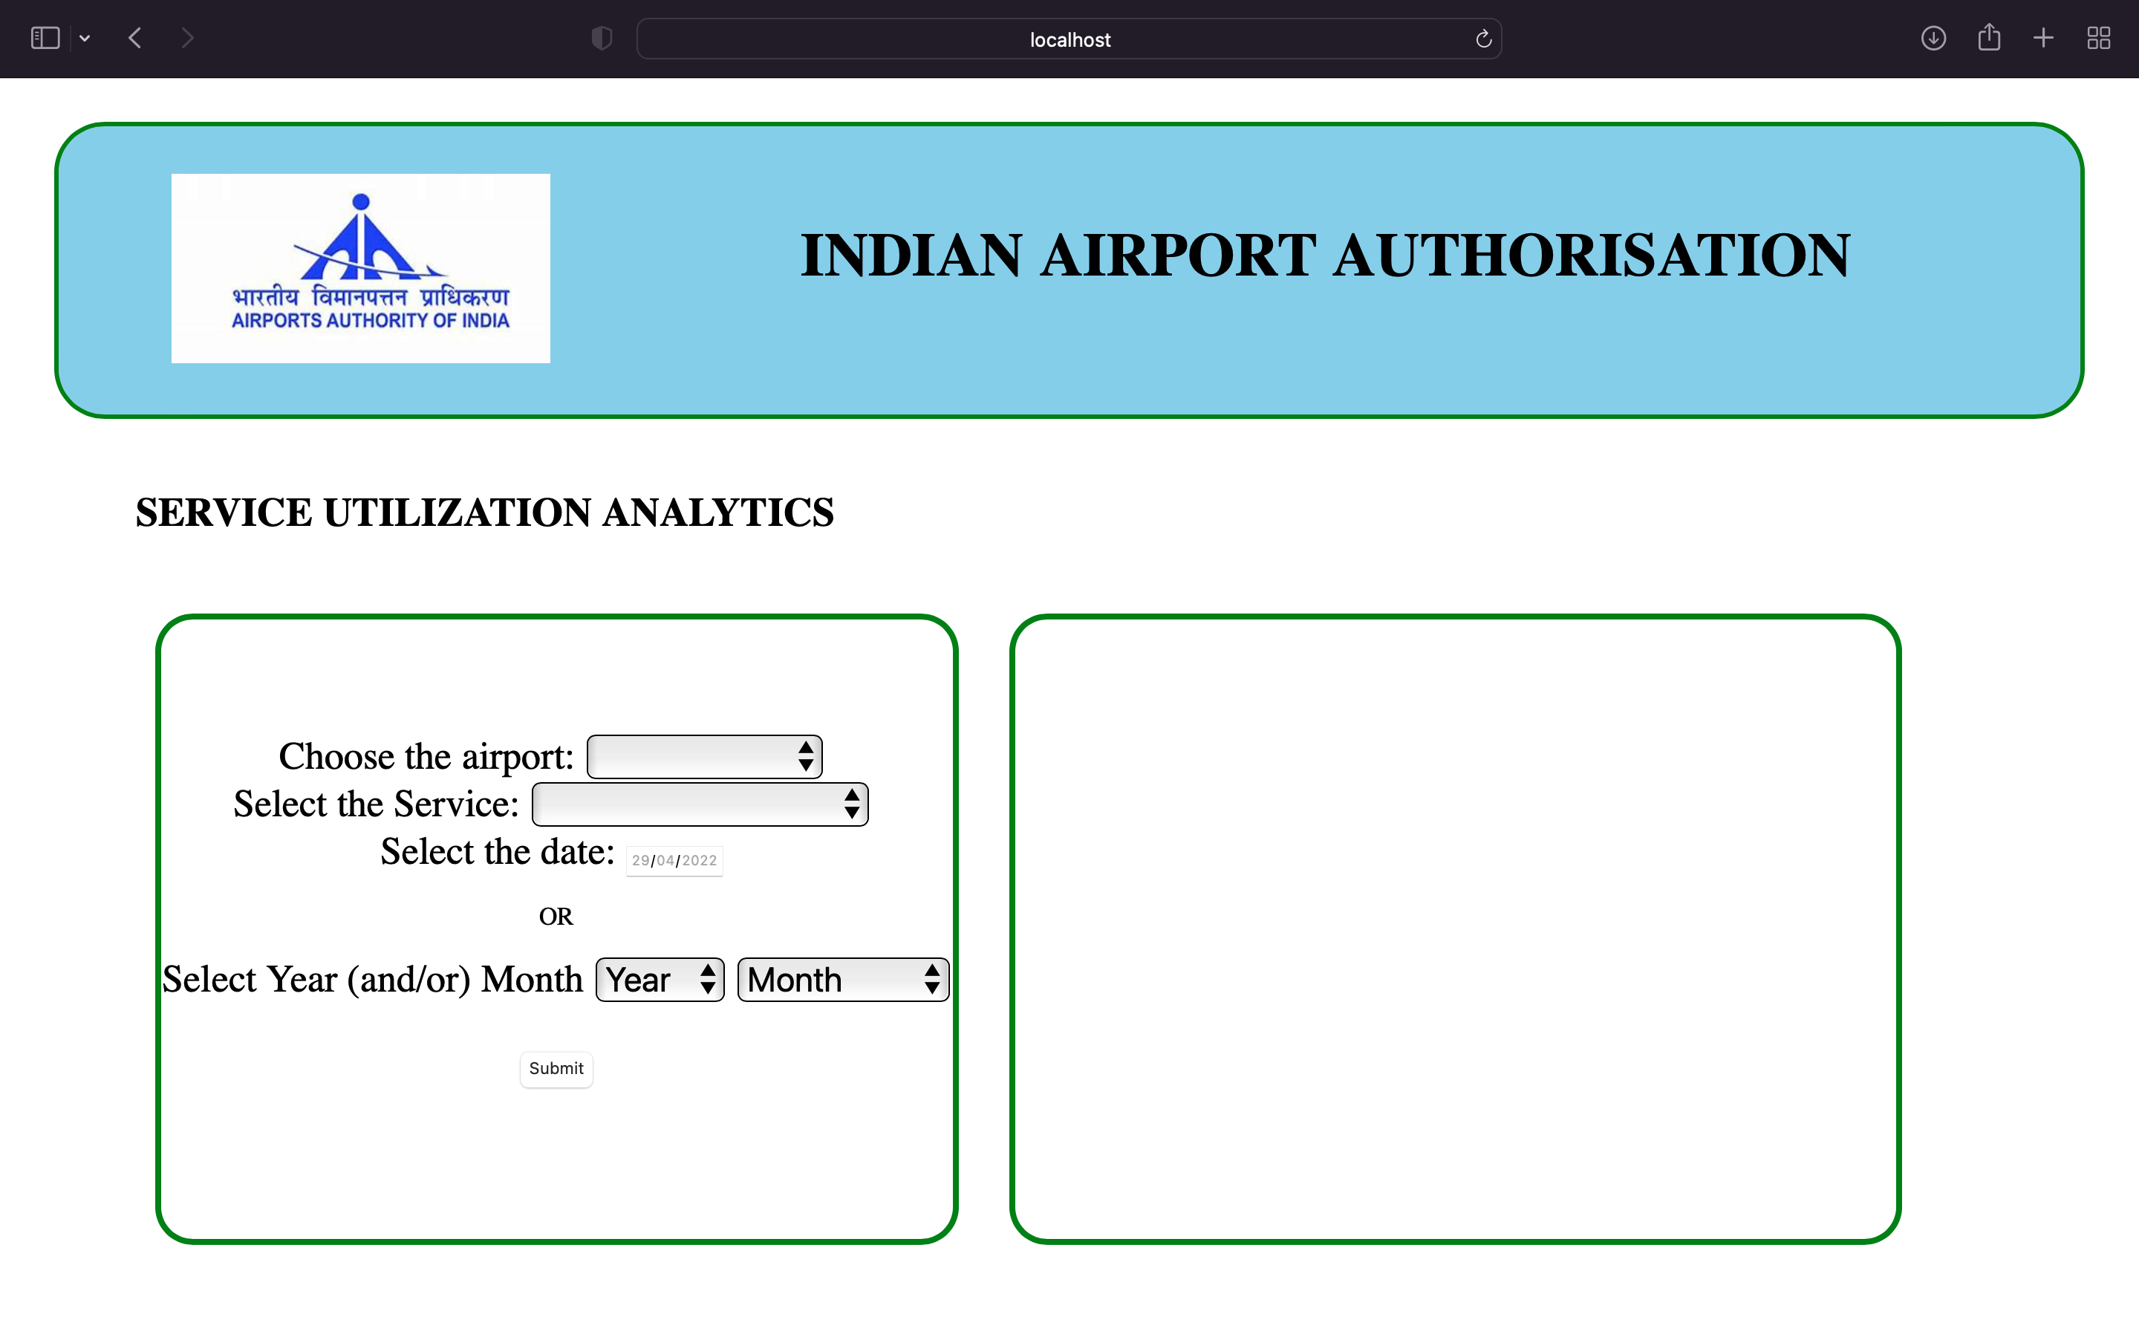

Slide 21
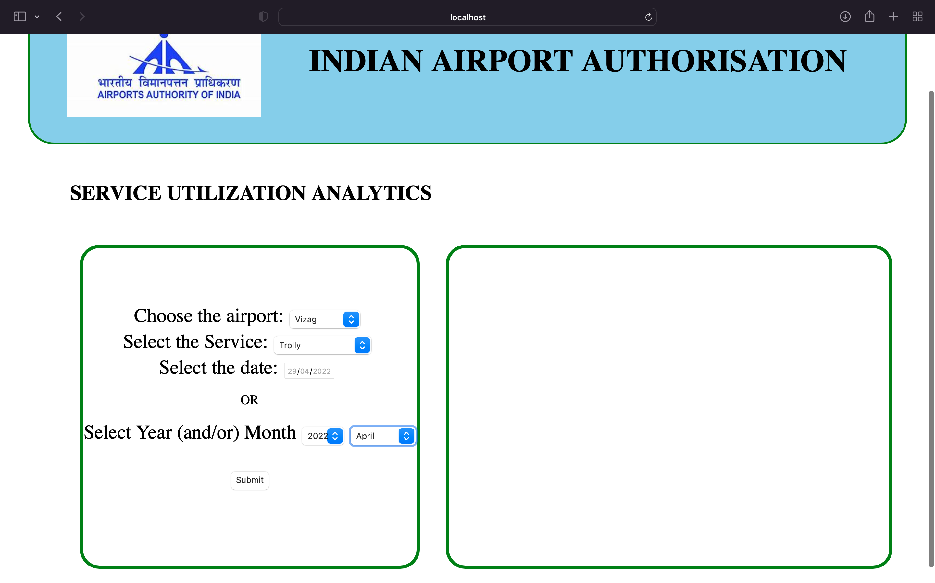

Slide 22
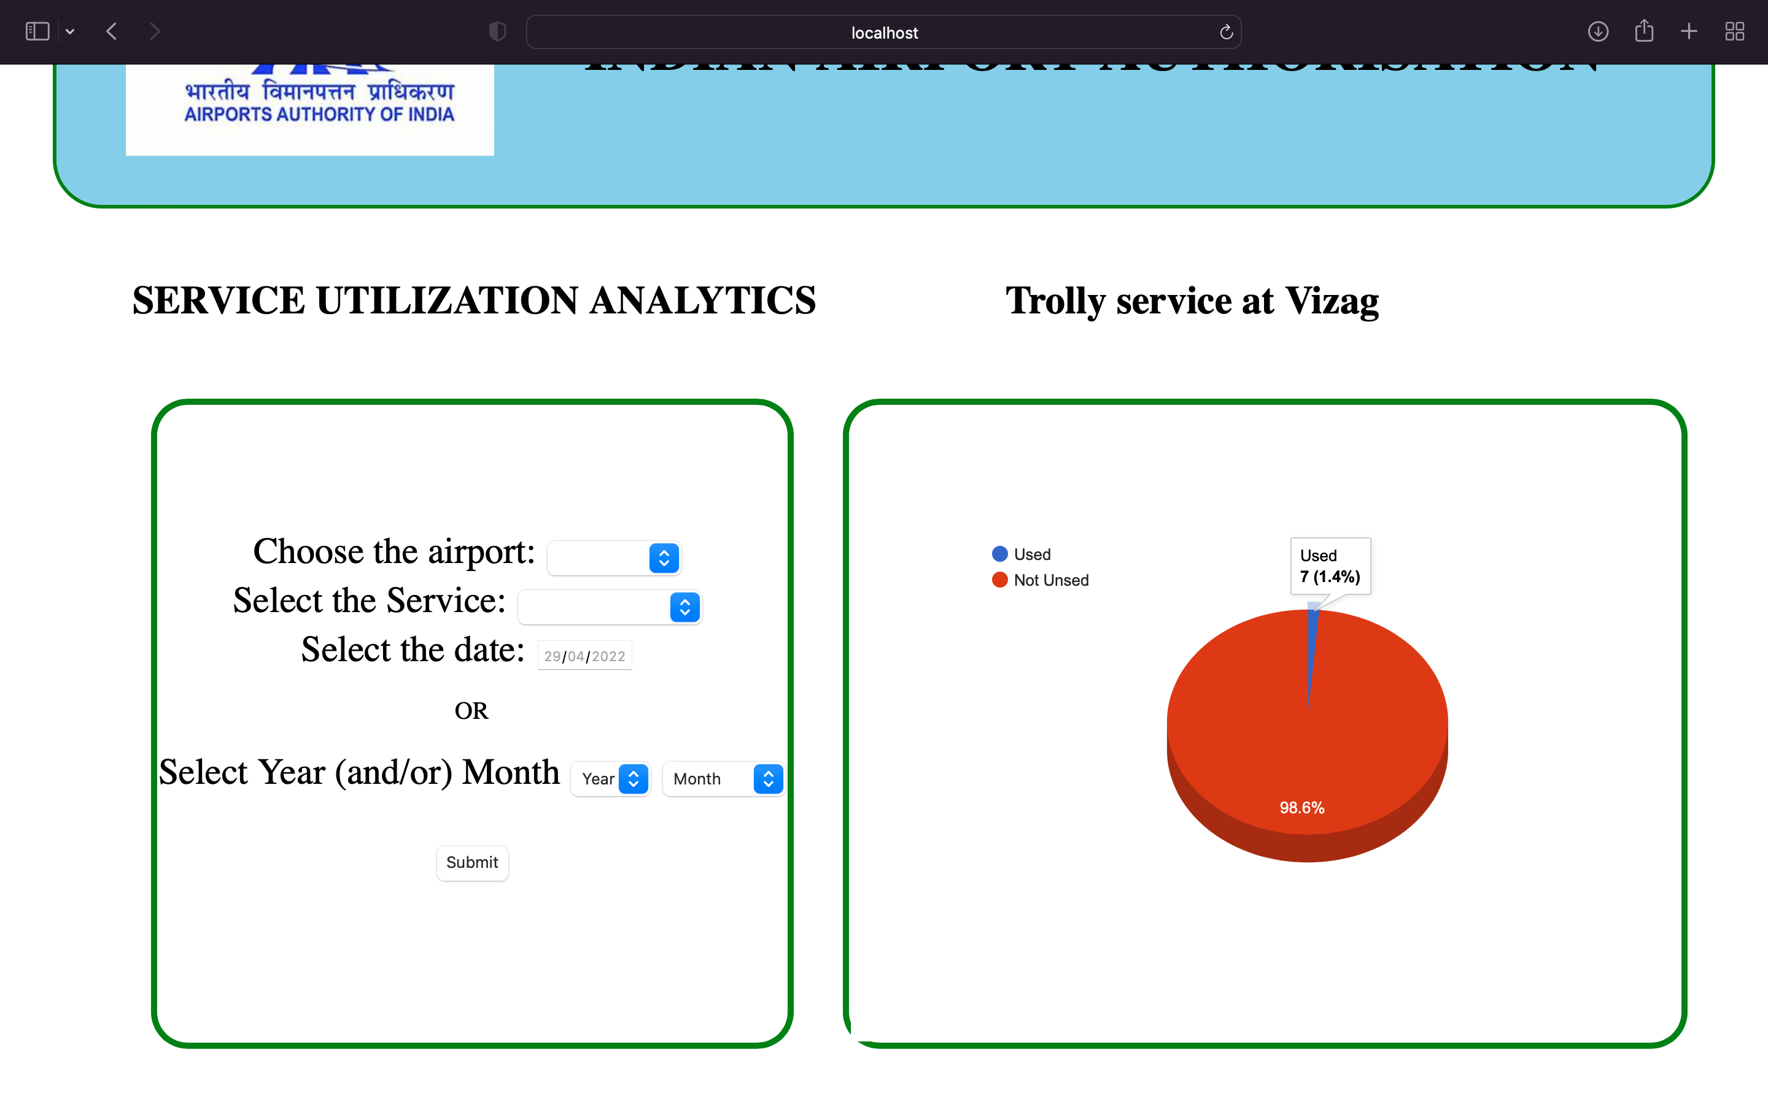

Slide 23


Slide 25

Any Queries

Slide 26

Thank You

